Slide 1
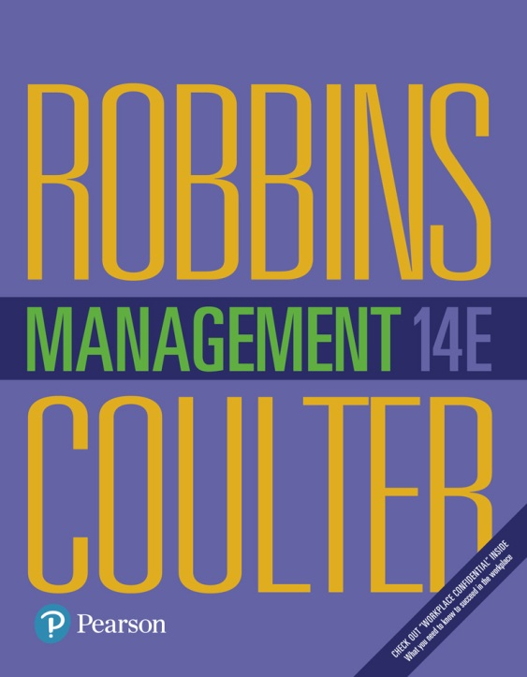
Management
Fourteenth Edition
Chapter 1
Managers and You in the Workplace
Copyright © 2018, 2016, 2014 Pearson Education, Inc. All Rights Reserved

Slide 2
Learning Objectives
1.1 Tell who managers are and where they work.
Know how to manage your time.
1.2 Explain why managers are important to organizations.
1.3 Describe the functions, roles, and skills of managers.
Develop your skill at being politically aware.
1.4 Describe the factors that are reshaping and redefining the manager’s job.
1.5 Explain the value of studying management.

Slide 3
Who Is a Manager?
Manager: someone who coordinates and oversees the work of other people so that organizational goals can be accomplished
Notes:
Managers run large corporations, medium-sized businesses, and entrepreneurial start-ups. They’re found in government departments, hospitals, small businesses, not-for-profit agencies, museums, schools, and even such nontraditional organizations such as political campaigns and music tours. In many organizations, the changing nature of work has blurred the distinction between managers and non-managerial employees. So, how do we define who managers are? A manager is someone who coordinates and oversees the work of other people so that organizational goals can be accomplished.

Slide 4
Exhibit 1-1 Levels of Management
Exhibit 1-1 shows that in traditionally structured organizations, managers can be classified as first-line, middle, or top.
Notes:
In traditionally structured organizations (often pictured as a pyramid because more employees are at lower organizational levels than at upper organizational levels), managers can be classified as first-line, middle, or top management.

Slide 5
Classifying Managers
First-Line Managers: manage the work of non-managerial employees
Middle Managers: manage the work of first-line managers
Top Managers: responsible for making organization-wide decisions and establishing plans and goals that affect the entire organization
Notes:
At the lowest level of management, first-line managers manage the work of non-managerial employees who typically are involved with producing the organization’s products or servicing the organization’s customers. First-line managers may be called supervisors or even shift managers, district managers, department managers, or office managers.
Middle managers manage the work of first-line managers and can be found between the lowest and top levels of the organization. They may have titles such as regional manager, project leader, store manager, or division manager.
At the upper levels of the organization are the top managers, who are responsible for making organization-wide decisions and establishing the plans and goals that affect the entire organization. These individuals typically have titles such as executive vice president, president, managing director, chief operating officer, or chief executive.

Slide 6
Where Do Managers Work?
Organization: a deliberate arrangement of people to accomplish some specific purpose
Notes:
What is an organization? It’s a deliberate arrangement of people to accomplish some specific purpose. Your college or university is an organization; so are fraternities and sororities, government departments, churches, Zynga, your neighborhood grocery store, the United Way, the St. Louis Cardinals baseball team, and the Mayo Clinic, all are considered organizations and have three common characteristics.
First, an organization has a distinct purpose typically expressed through goals the organization hopes to accomplish. Second, each organization is composed of people. It takes people to perform the work that’s necessary for the organization to achieve its goals. Third, all organizations develop a deliberate structure within which members do their work.

Slide 7
Exhibit 1-2 Characteristics of Organizations
Exhibit 1-2 shows the three common characteristics of organizations: distinct purpose, deliberate structure, and people.
Notes:
In traditionally structured organizations (often pictured as a pyramid because more employees are at lower organizational levels than at upper organizational levels), managers can be classified as first-line, middle, or top management.

Slide 8
Why Are Managers Important?
Organizations need their managerial skills and abilities now more than ever
Managers are critical to getting things done
Managers do matter to organizations
Notes:
Let’s look at three reasons why managers are important to organizations.
First, managers are important because organizations need their managerial skills and abilities more than ever in uncertain, complex, and chaotic
times. As organizations deal with today’s challenges, managers play an important role in identifying critical issues and crafting responses.
Another reason why managers are important to organizations is because they’re critical to getting things done. The job of a manager is to ensure that all the employees are getting their jobs done.
Managers matter. A Gallup poll has found that the single most important variable in employee productivity and loyalty isn’t pay, or benefits, or the workplace environment—it’s the quality of the relationship between employees and their direct supervisors.

Slide 9
What Do Managers Do?
Management involves coordinating and overseeing the work activities of others so that their activities are completed efficiently and effectively.
Notes:
Management involves coordinating and overseeing the work activities of others so their activities are completed efficiently and effectively. While coordinating and overseeing the work of others is what distinguishes a managerial position from a non-managerial one, this doesn’t mean that managers can do what they want anytime, anywhere, or in any way. Instead, management involves ensuring that work activities are completed efficiently and effectively by the people responsible for doing them, or, at least that’s what managers should be doing.

Slide 10
Efficiency and Effectiveness
Efficiency: doing things right
getting the most output from the least amount of input
Effectiveness: doing the right things
attaining organizational goals
Notes:
Efficiency refers to getting the most output from the least amount of inputs or resources. Managers deal with scarce resources—including people, money, and equipment—and want to use those resources efficiently.
Effectiveness is often described as “doing the right things,” that is, doing those work activities that will result in achieving goals.
Whereas efficiency is concerned with the means of getting things done, effectiveness is concerned with the ends, or attainment of organizational goals.

Slide 11
Exhibit 1-3 Efficiency and Effectiveness in Management
Exhibit 1-3 shows that whereas efficiency is concerned with the means of getting things done, effectiveness is concerned with the ends, or attainment of organizational goals.

Slide 12
Management Functions
Planning: Defining goals, establishing strategies to achieve goals, and developing plans to integrate and coordinate activities
Organizing: Arranging and structuring work to accomplish organizational goals
Lending: Working with and through people to accomplish goals
Controlling: Monitoring, comparing, and correcting work
Notes:
According to the functions approach, managers perform certain activities or functions as they efficiently and effectively coordinate the work of others. What are these functions? Henri Fayol, a French businessman, first proposed in the early part of the twentieth century that all managers perform five functions: planning, organizing, commanding, coordinating, and controlling. Today, these functions have been condensed to four: planning, organizing, leading, and controlling (see Exhibit 1-4).

Slide 13
Exhibit 1-4 Four Functions of Management
Exhibit 1-4 shows the four functions used to describe a manager’s work: planning, organizing, leading, and controlling.
Notes:
As managers engage in planning, they set goals, establish strategies for achieving those goals, and develop plans to integrate and coordinate activities.
When managers organize, they determine what tasks are to be done, who is to do them, how the tasks are to be grouped, who reports to whom, and where decisions are to be made.
When managers motivate subordinates, help resolve work group conflicts, influence individuals or teams as they work, select the most effective communication
channel, or deal in any way with employee behavior issues, they’re leading. To ensure goals are met and work is done as it should be, managers monitor and evaluate performance. Actual performance is compared with the set goals. If those goals aren’t achieved, it’s the manager’s job to get work back on track.
This process of monitoring, comparing, and correcting is the controlling function.

Slide 14
Mintzberg’s Managerial Roles and a Contemporary Model of Managing
Roles: specific actions or behaviors expected of and exhibited by a manager
Mintzberg identified 10 roles grouped around interpersonal relationships, the transfer of information, and decision-making
Notes:
Henry Mintzberg, a well-known management researcher, studied actual managers at work. In his first comprehensive study, Mintzberg concluded that what managers do can best be described by looking at the managerial roles they engage in at work. The term managerial roles refers to specific actions or behaviors expected of, and exhibited by, a manager.

Slide 15
Types of Roles
Interpersonal
Figurehead, leader, liaison
Informational
Monitor, disseminator, spokesperson
Decisional
Entrepreneur, disturbance handler, resource allocator, negotiator
Notes:
As shown in Exhibit 1-5, these 10 roles are grouped around interpersonal relationships, the transfer of information, and decision-making.
The interpersonal roles involve people (subordinates and persons outside the organization) and other ceremonial and symbolic duties. The three interpersonal
roles include figurehead, leader, and liaison.
The informational roles involve collecting, receiving, and disseminating information. The three informational roles include monitor, disseminator, and spokesperson.
Finally, the decisional roles entail making decisions or choices and include entrepreneur, disturbance handler, resource allocator,
and negotiator.

Slide 16
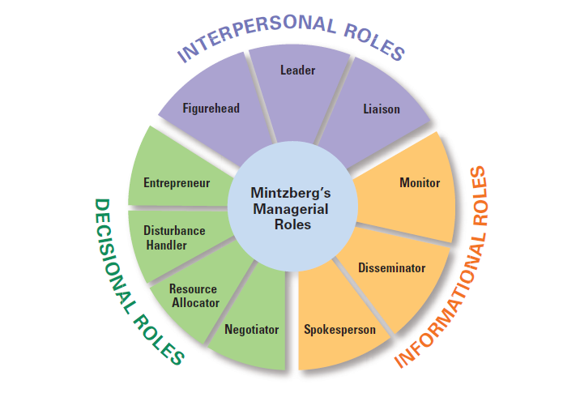
Exhibit 1-5 Mintzberg’s Managerial Roles
Exhibit 1-4 shows the four functions used to describe a manager’s work: planning, organizing, leading, and controlling.
Notes:
Source: Based on H. Mintzberg, The Nature of Managerial Work (New York: Prentice Hall, 1983).

Slide 17
Management Skills
Technical skills
Knowledge and proficiency in a specific field
Human skills
The ability to work well with other people
Conceptual skills
The ability to think and conceptualize about abstract and complex situations concerning the organization
Notes:
What types of skills do managers need? Robert L. Katz proposed that managers need three critical skills in managing: technical, human, and conceptual.
Technical skills are the job-specific knowledge and techniques needed to proficiently perform work tasks. These skills tend to be more important for first-line managers because they typically manage employees who use tools and techniques to produce the organization’s products or service the organization’s customers.
Human skills involve the ability to work well with other people both individually and in a group. Because all managers deal with people, these skills are equally important to all levels of management.
Finally, conceptual skills are the skills managers use to think and to conceptualize about abstract and complex situations. Using these skills, managers see the organization as a whole, understand the relationships among various subunits, and visualize how the organization fits into its broader environment. These skills are most important
to top managers.

Slide 18
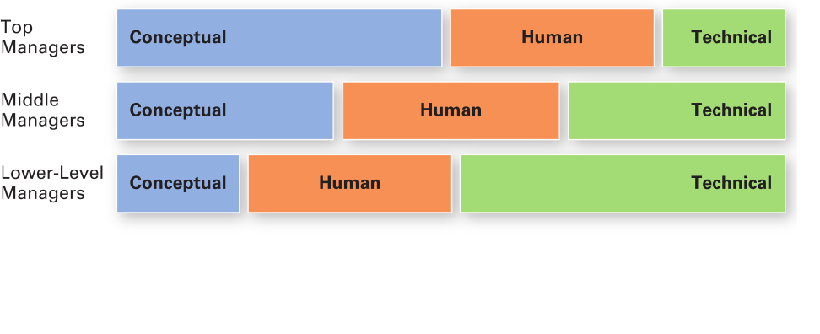
Exhibit 1-6 Skills Needed at Different Managerial Levels
Exhibit 1-6 shows the relationships of conceptual, human, and technical skills to managerial levels.

Slide 19
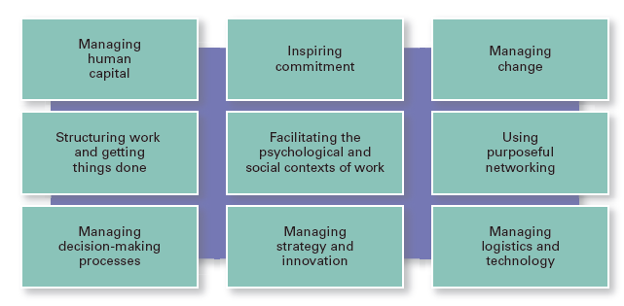
Exhibit 1-7 Important Managerial Skills
Exhibit 1-7 shows other important managerial skills.
Notes:
Source: Based on Workforce Online; J. R. Ryan, Bloomberg BusinessWeek Online; In-Sue Oh and C. M. Berry; and R. S. Rubin and E. C. Dierdorff.

Slide 20
Exhibit 1-8 Changes Facing Managers
Exhibit 1-8 shows some of the most important changes facing managers.
Notes:
In today’s world, managers are dealing with global economic and political uncertainties, changing workplaces, ethical issues, security threats, and changing technology. It’s likely that more managers will have to manage under such demanding circumstances, and the fact is that how managers manage is changing. Exhibit 1-8 shows some of the most important changes facing managers.

Slide 21
Focus on the Customer
Without customers, most organizations would cease to exist
Managing customer relationships is the responsibility of all managers and employees
Consistent, high-quality customer service is essential
Notes:
You need customers. Without them, most organizations would cease to exist. Yet, focusing on the customer has long been thought to be the responsibility of marketing types. Today, the majority of employees in developed countries work in service jobs. Almost 77 percent of the U.S. labor force is employed in service industries.

Slide 22
Focus on Technology
Managers must get employees on board with new technology
Managers must oversee the social interactions and challenges involved in using collaborative technologies
Notes:
Managers must work with employees to understand why new technology is an improvement over present ways of conducting business. According to Didier Bonnet, coauthor of Leading Challenge, “The job of a manager is to help people cross the bridge—to get them comfortable with the technology, to get them using it, and to help them understand how it makes their lives better.”
It is a myth that social skills have become less important because there is more technology in the workplace. Particularly in team settings, workers rely on each other’s expertise, and they are able to adapt to changing circumstances than is made possible by software. As a result, managers are continually challenged to oversee team building and problem solving.

Slide 23
Focus on Social Media
Social media: forms of electronic communication through which users create online communities to share ideas, information, personal messages, and other content
Notes:
Today, the new frontier is social media, forms of electronic communication through which users create online communities to share ideas, information, personal messages, and other content. And employees don’t just use these on their personal time, but also for work purposes. That’s why managers need to understand and manage the power and peril of social media.
Increasingly, many companies encourage employees to use social media to become employee activists. For this purpose, employee activists draw visibility to their workplace, defend their employers from criticism, and serve as advocates, both online and off.
Internally, social media also becomes problematic when it becomes a way for boastful employees to brag about their accomplishments, for managers to publish one-way messages to employees, or for employees to argue or gripe about something or someone they don’t like at work—then it has lost its usefulness. To avoid this, managers need to remember that social media is a tool that needs to be managed to be beneficial.

Slide 24
Focus on Innovation
Innovation: exploring new territory, taking risks, and doing things differently
Notes:
Innovation means doing things differently, exploring new territory, and taking risks. Innovation isn’t just for high-tech or other technologically sophisticated organizations. Innovative efforts can be found in all types of organizations.

Slide 25
Focus on Sustainability
Sustainability: a company’s ability to achieve its business goals and increase long-term shareholder value by integrating economic, environmental, and social opportunities into its business strategies
Notes:
What’s emerging in the twenty-first century is the concept of managing in a sustainable way, which has had the effect of widening corporate responsibility not only to managing in an efficient and effective way, but also to responding strategically to a wide range of environmental and societal challenges. From a business perspective, sustainability has been defined as a company’s ability to achieve its business goals and increase long-term shareholder value by integrating economic, environmental, and social opportunities into its business strategies.

Slide 26
Focus on the Employee
Treating employees well is not only the right thing to do, it is also good business
Notes:
Progressive companies recognize the importance of treating employees well not only because it’s simply the right thing to do, but also because it is good business. Well-treated employees are more likely to go the extra mile when performing their job
Successful managers regularly provide performance feedback that serves as an evaluation of an employee’s performance and provides the foundation for discussing developmental opportunities. Effective performance appraisal outcomes depend on clearly communicating performance expectations and the resources available to help employees perform well and providing feedback on how well expectations were met.
Successful managers often embrace work-life practices and provide encouragement to employees who wish to use them.

Slide 27
The Universality of Management
The reality that management is needed in all types and sizes of organizations, at all organizational levels, in all organizational areas, and in organizations no matter where located
Notes:
We can say with absolute certainty that management is needed in all types and sizes of organizations, at all organizational levels and in all organizational work areas, and in all organizations, no matter where they’re located. This is known as the universality of management (see Exhibit 1-9.)

Slide 28
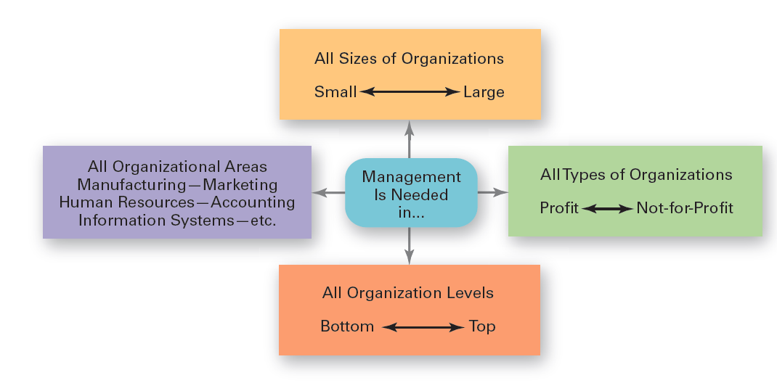
Exhibit 1-9 Universal Need for Management
Exhibit 1-9 shows that management is universally needed in all types of, and throughout all areas of, organizations.
Notes:
Effective management is universally needed in all organizations, therefore it’s imperative to find ways to improve the way organizations are managed. Why? Because we interact with organizations every single day. Organizations influence every aspect of our lives.

Slide 29
The Reality of Work
When you begin your career, you will either manage or be managed.
Notes:
Another reason for studying management is the reality that for most of you, once you graduate from college and begin your career, you will either manage or be managed. For those who plan to be managers, an understanding of management forms the foundation upon which to build your management knowledge and skills. For those of you who don’t see yourself managing, you’re still likely to have to work with managers.
Also, assuming that you’ll have to work for a living and recognizing that you’re very likely to work in an organization, you’ll probably have some managerial responsibilities even if you’re not a manager. Our experience tells us that you can gain a great deal of insight into the way your boss (and fellow employees) behave and how organizations function by studying management

Slide 30
Challenges of Being a Manager
Can be a thankless job
May entail clerical type duties
Managers also spend significant amounts of time in meetings and dealing with interruptions
Managers often have to deal with a variety of personalities and have to make do with limited resources
Notes:
There are many challenges to being a manager. It can be a tough and often thankless job. Additionally, a portion of a manager’s job (especially at lower organizational levels) may entail duties that are often more clerical (compiling and filing reports, dealing with bureaucratic procedures, or doing paperwork) than managerial. A large percentage of managers spend significant amounts of time in meetings and deal with interruptions, which can be time consuming and sometimes unproductive. Managers often have to deal with a variety of personalities and have to make do with limited resources. It can be a challenge to motivate workers in the face of uncertainty and chaos, which are constants in management regardless of the field or discipline.

Slide 31
Rewards of Being a Manager
Responsible for creating a productive work environment
Recognition and status in your organization and in the community
Attractive compensation in the form of salaries, bonuses, and stock options
Notes:
Despite challenges, being a manager can be rewarding. You’re responsible for creating a work environment in which organizational members can do their work to the best of their ability and thus help the organization achieve its goals. You help others find meaning and fulfillment in their work. You get to support, coach, and nurture others and help them make good decisions. In addition, as a manager, you often have the opportunity to think creatively and use your imagination. You’ll get to meet and work with a variety of people—both inside and outside the organization. Other rewards may include receiving recognition and status in your organization and in the community, playing a role in influencing organizational outcomes, and receiving attractive compensation in the form of salaries, bonuses, and stock options.

Slide 32
Exhibit 1-10 Rewards and Challenges of Being a Manager
Rewards | Challenges
Create a work environment in which organizational members can work to the best of their ability | Do hard work
Have opportunities to think creatively and use imagination | May have duties that are more clerical than managerial
Help others find meaning and fulfillment in work | Have to deal with a variety of personalities
Support, coach, and nurture others | Often have to make do with limited resources
Work with a variety of people | Motivate workers in chaotic and uncertain situations
Receive recognition and status in community and organization | Blend knowledge, skills, ambitions, and experiences of diverse work group
Play a role in influencing organizational outcomes | Success depends on others’ work performance
Receive appropriate compensation in the form of salaries, bonuses, and stock options | Blank cell
Good mangers are needed by organizations | Blank cell

Slide 33
Review Learning Objective 1.1
Tell who managers are and where they work.
Managers coordinate and oversee the work of other people so that organizational goals can be accomplished.
Managers work in an organization, which is a deliberate arrangement of people to accomplish some specific purpose.

Slide 34
Review Learning Objective 1.2
Explain why managers are important to organizations.
Organizations need their managerial skills and abilities in uncertain, complex, and chaotic times.
Managers are critical to getting things done in organizations.
Managers contribute to employee productivity and loyalty.

Slide 35
Review Learning Objective 1.3 (1 of 3)
Describe the functions, roles, and skills of managers.
Management involves coordinating and overseeing the efficient and effective completion of others’ work activities.
The four functions of management include planning, organizing, leading, and controlling.

Slide 36
Review Learning Objective 1.3 (2 of 3)
Mintzberg’s managerial roles include:
Interpersonal, involve people and other ceremonial/symbolic duties (figurehead, leader, and liaison)
Informational, collecting, receiving, and disseminating information (monitor, disseminator, and spokesperson)
Decisional, making choices (entrepreneur, disturbance handler, resource allocator, and negotiator)

Slide 37
Review Learning Objective 1.3 (3 of 3)
Katz’s managerial skills include:
Technical (job-specific knowledge and techniques)
Human (ability to work well with people)
Conceptual (ability to think and express ideas)

Slide 38
Review Learning Objective 1.4
Describe the factors that are reshaping and redefining the manager’s job.
Managers must be concerned with:
Customer service because employee attitudes and behaviors play a big role in customer satisfaction
Technology as it impacts how things get done in organizations
Social media because these forms of communication are becoming important and valuable tools in managing
Innovation because it is important for organizations to be competitive
Sustainability as business goals are developed
Employees in order for them to be more productive

Slide 39
Review Learning Objective 1.5
Explain the value of studying management.
The universality of management—managers are needed in all types and sizes of organizations
The reality of work—you will manage or be managed
Significant rewards and challenges

Slide 40
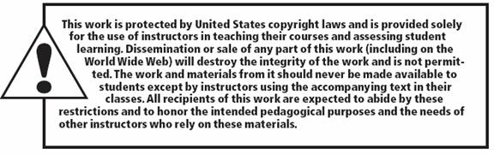
Copyright

